Slide 1

DriverPass System Analysis
Carlos Trujillo
Notes:
[No speaker notes required for this slide.]

Slide 2

System Requirements
Functional needs: registration, scheduling, test tracking
Nonfunctional needs: performance, security, usability
Notes:
We built this system to let your customers register, schedule driving lessons, take practice tests, and track their progress. On the backend, your team can manage users, appointments, and DMV updates. The system is web-based, responsive, and designed to run smoothly across desktop and mobile devices. It’s also secure and scalable, meaning it can grow with your business.

Slide 3
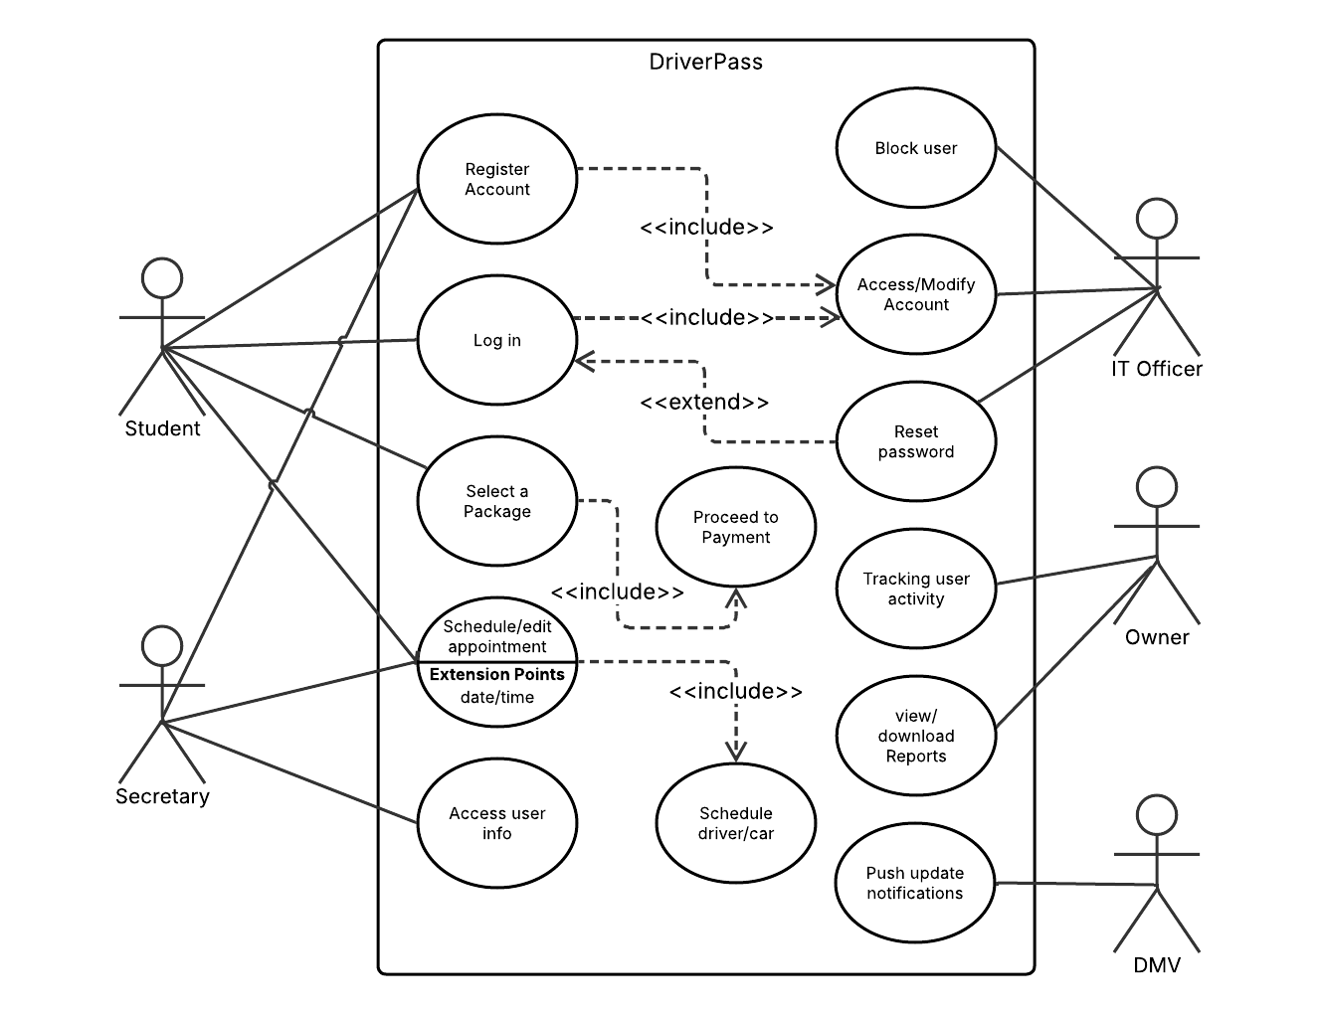
Use Case Diagram
Notes:
This diagram shows the different people who use the system—students, secretaries, IT staff, and the DMV—and what they can do. For example, students can register, choose a training package, and schedule appointments. Secretaries can help manage schedules, and IT staff can handle user support like resetting passwords or blocking accounts when needed.

Slide 4
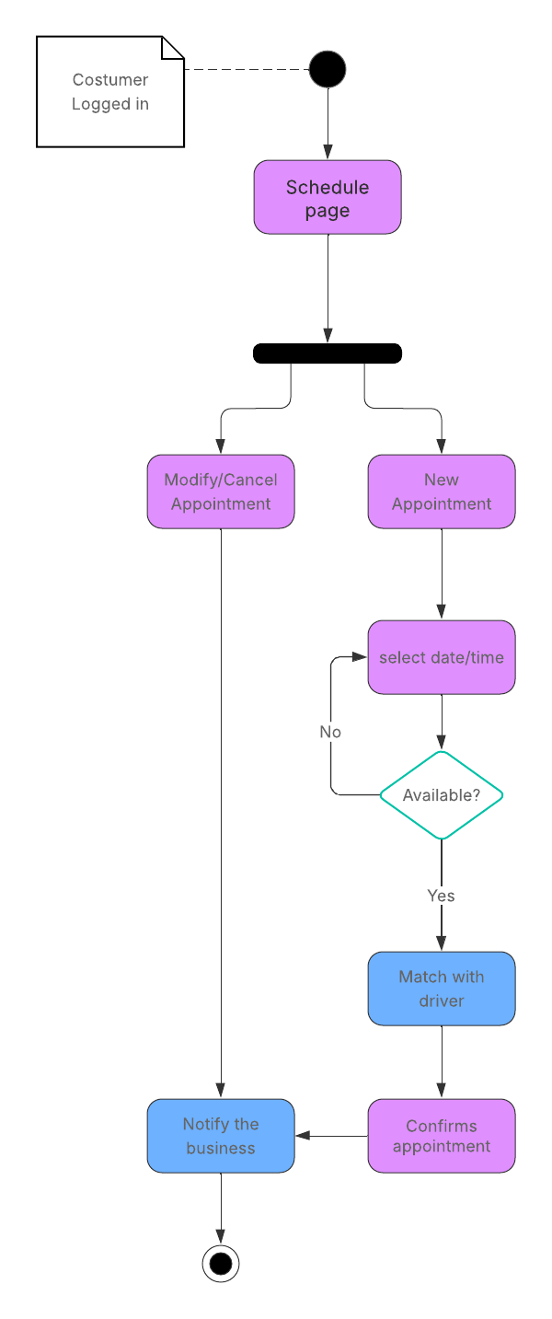
Activity Diagram
Notes:
This diagram walks through what happens when a student schedules a lesson. First, they log in, choose a lesson time, and the system checks if it’s available. If the time works, the appointment is booked and a confirmation is sent. This process is designed to be smooth and automated, saving time for both students and staff.

Slide 5
Security
Password protection
Brute-force lockout
Encrypted data
Notes:
Security is a top priority. All user information is protected by password authentication, and the system automatically locks out accounts after too many failed login attempts (3). We also use encryption to keep all data safe while it’s being transmitted or stored, giving peace of mind to both your team and your customers.

Slide 6
System Limitations
Limited to essential features for launch
Developers must add new packages
Requires internet access
Notes:
While the system covers all core functions, we kept things lean for the initial launch. Right now, only developers can add new training packages, and some advanced features like offline access aren’t included. That said, the system is designed to be easily upgraded over time.

